Slide 1
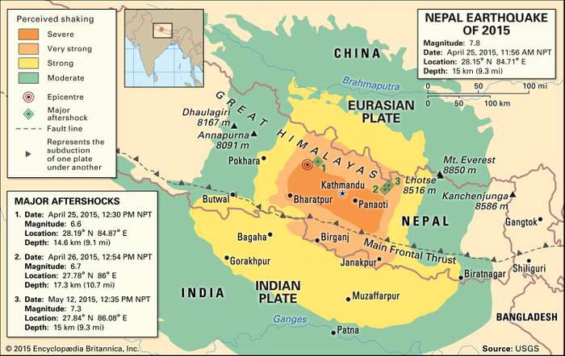
Problem Statement
Richter's Predictor: Modeling Earthquake Damage
We're trying to predict the ordinal variable damage_grade, which represents a level of damage to the building that was hit by the earthquake. There are 3 grades of the damage:
1 represents low damage
2 represents a medium amount of damage
3 represents almost complete destruction
Performance Matrix
To measure the performance of our algorithms, we'll use the accuracy and F1 score which balances the precision and recall of a classifier.
Traditionally, the F1 score is used to evaluate performance on a binary classifier, but since we have three possible labels we will use a variant called the micro averaged F1 score.
Fmicro=(2*P_micro*R_micro )/( P_micro + R_micro )

Slide 2
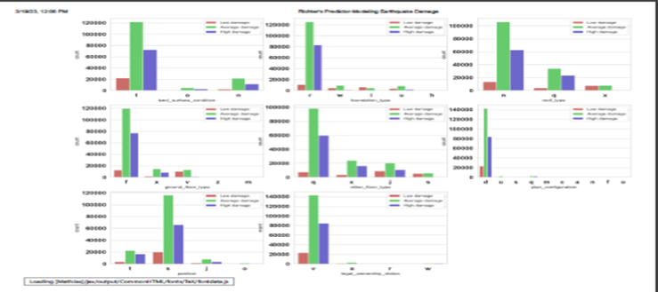
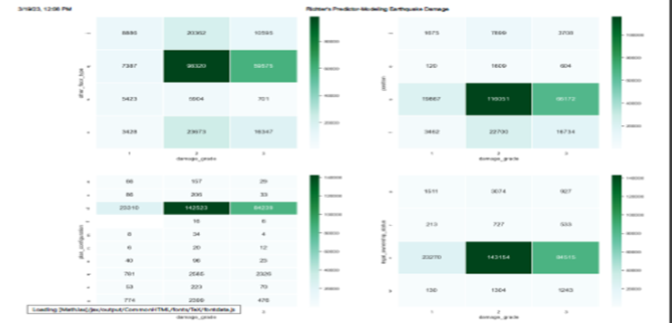
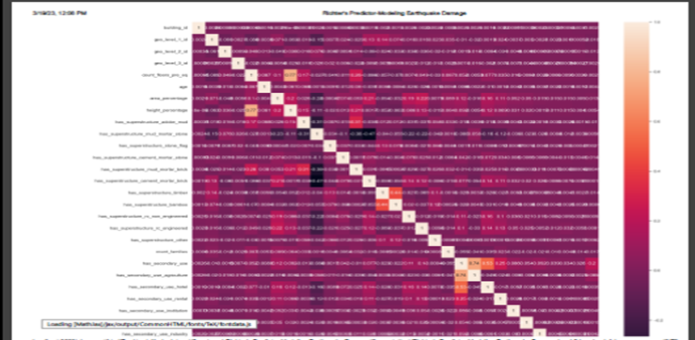
Model Building Process
import pandas as pd
import numpy as np
import matplotlib.pyplot as plt
%matplotlib inline
import seaborn as sns, sns.set()
import warnings
warnings.filterwarnings('ignore')
Importing Libraries
Descriptive Statistics
train.describe()
train.isnull().sum()
for i in train_new.columns:
print(train_new[i].value_counts())
Exploratory Data Analysis
sns.countplot
Categorical subplot using for loop
sns.heatmap with group by clause
sns.heatmap for correlation
Hypothesis Testing f_oneway, chi2_contingency with if_else statement

Slide 3
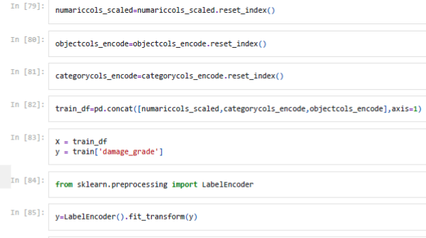
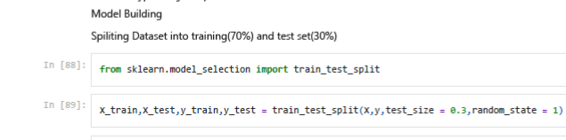
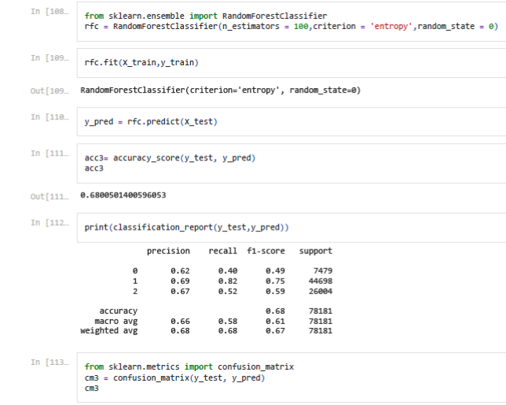
Model Building Process
# Split data into objectcols and numericals
objectcols=train.select_dtypes(include=['object'])
numariccols=train.select_dtypes(include=np.number)
# from sklearn.preprocessing import LabelEncoder
# from sklearn.preprocessing import StandardScaler
X = train_df
y = train['damage_grade']
Data Transformation
Machine learning Models
from sklearn.linear_model import LogisticRegression
from sklearn.tree import DecisionTreeClassifier
from sklearn.ensemble import RandomForestClassifier
from sklearn.naive_bayes import GaussianNB
from sklearn.ensemble import GradientBoostingClassifier
from sklearn.neighbors import KNeighborsClassifier
Models Parameters and Classification Report
y_pred = model.predict(X_test)
# Create a classification report for the model.
from sklearn.metrics import classification_report
print(classification_report(y_test,y_pred))
from sklearn.metrics import accuracy_score
from sklearn.metrics import ConfusionMatrixDisplay

Slide 4
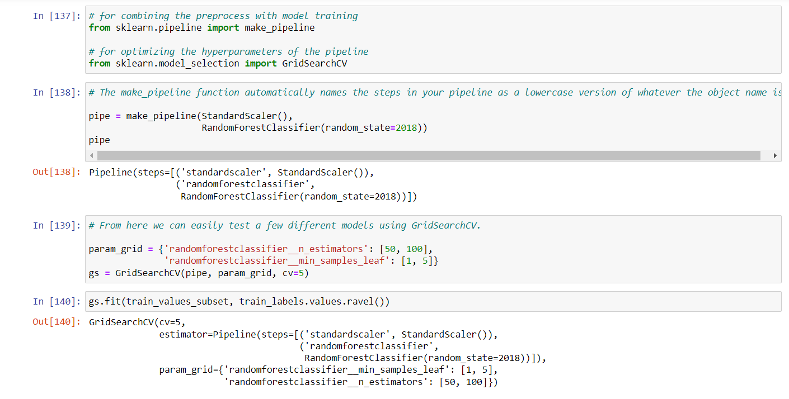
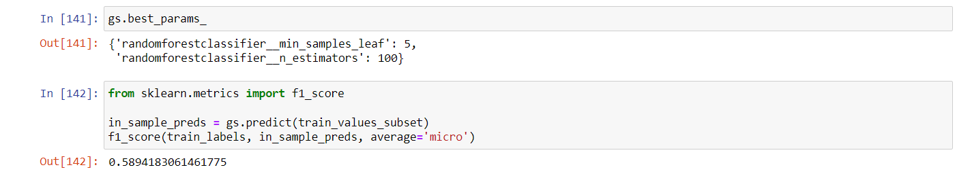
Model Building Process
Fmicro=(2⋅Pmicro⋅Rmicro)/(Pmicro+Rmicro)
# for combining the preprocess with model training
from sklearn.pipeline import make_pipelinemport
# for optimizing the hyperparameters of the pipeline
from sklearn.model_selection import GridSearchCV
from sklearn.metrics import f1_score
Evaluation Matrix and Grid search CV
Submission on Test data
test_values =pd.read_csv('test_values.csv’,
index_col='building_id’)
predictions = gs.predict(test_values_subset)
submission_format = pd.read_csv('submission_format.csv', index_col='building_id')

Slide 5
Analysis
The target variable is imbalanced, The training data is semi-anonymized so domain knowledge could not be applied to perform feature engineering. models which were tried are Logistic Regression, Decision Tree Algorithm, Random Forest Algorithm, Gaussian Naive Bayes, Gradient Boosting Machine, KNeighborsClassifier Only Random Forest happened to give highest accuracy.
With the current model, we are getting accuracy of 0.68. We will check F micro evaluation matrix for random forest as well as other models .
We can go for neural network approach as well .
Findings/Summary
What's next?
Conclusion
Model Accuracy
The target value is imbalanced. Maximum damage happened to 2-storey buildings
Building's age is binned in intervals of 5. Most of the building are 0-100 years old.
Most of the damaged buildings are single family homes. We can infer that most of the damage happened to residential areas
Logistic Regression-0.571724
Decision Tree Algorithm-0.596091
Random Forest Algorithm -0.6800501
Gaussian Naive Bayes- 0.5716222
Gradient Boosting Machine - 0.63997646
KNeighborsClassifier- 0.495248

Slide 6
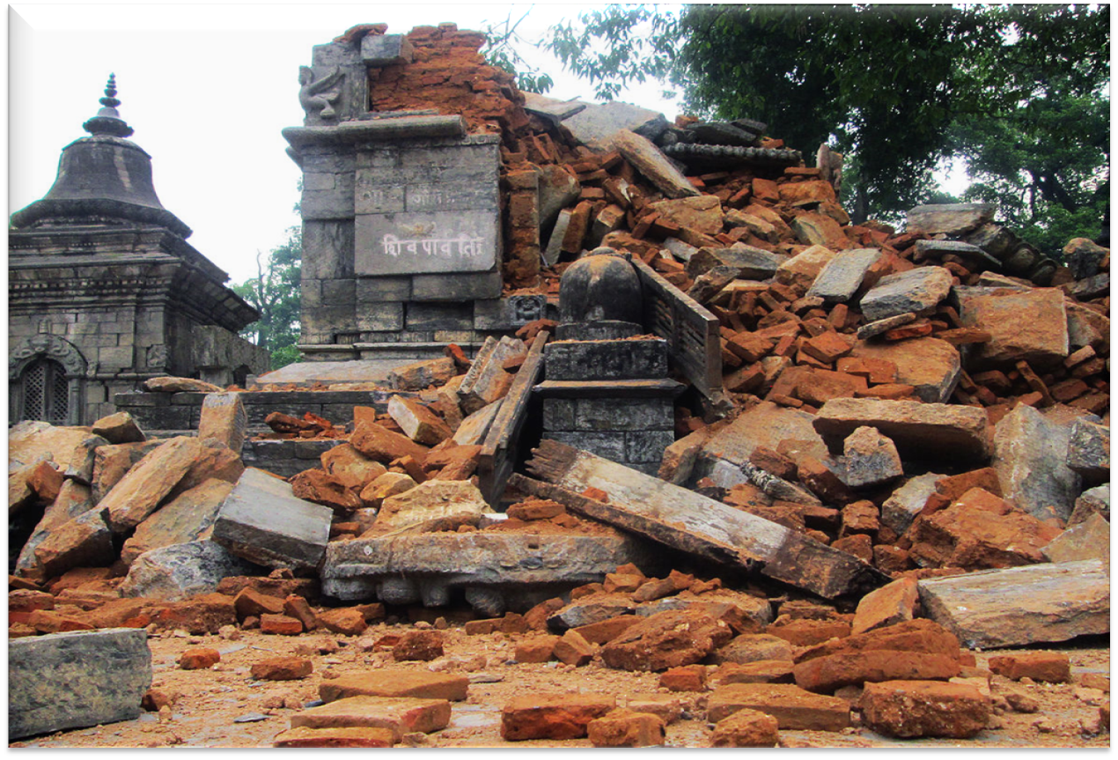
Thank you
Richter's Predictor: Modeling Earthquake Damage Based on aspects of building location and construction,
your goal is to predict the level of damage to buildings caused by the 2015 Gorkha earthquake in Nepal
Snehit Shelke​
Guided by,
Rajesh Prabhakar Kaila
+91 8668916259
Sgshelke.1410@gmail.com
6
Snehit Shelke

